Slide 1
Goal-Setting
Lauren Gooden, graduate student
Virginia Commonwealth University

Slide 2
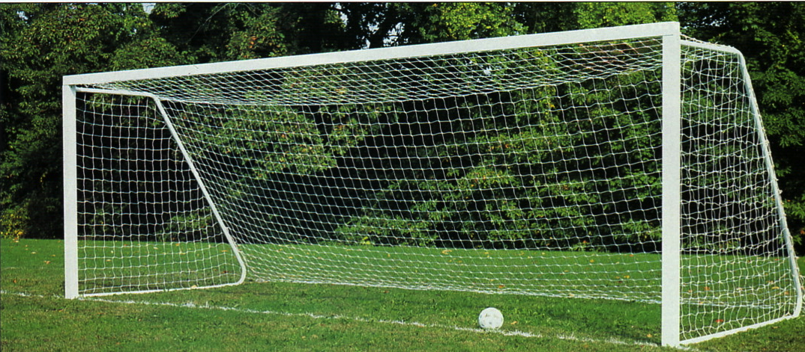
What is a goal?
….and why are they important?
Image retrieved from Google Images

Slide 3
Steps for setting a goal
Image retrieved from http://thestudyacademy.ca/tag/goal-setting/

Slide 4
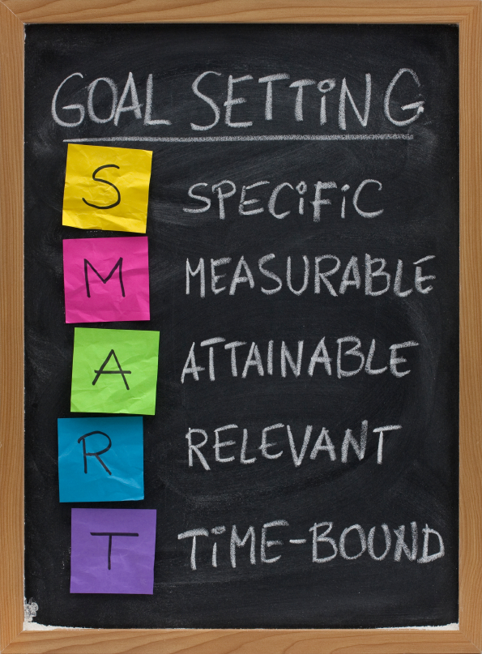
Image retrieved from http://thestudyacademy.ca/tag/goal-setting/

Slide 5
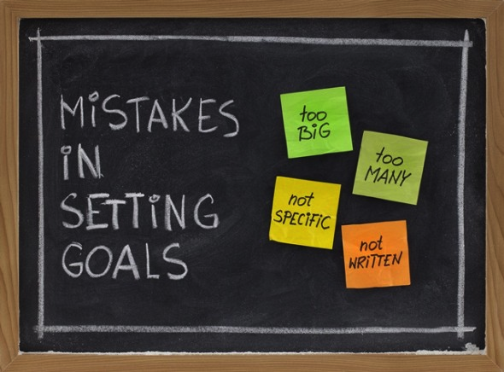
Image retrieved from http://thestudyacademy.ca/tag/goal-setting/

Slide 6
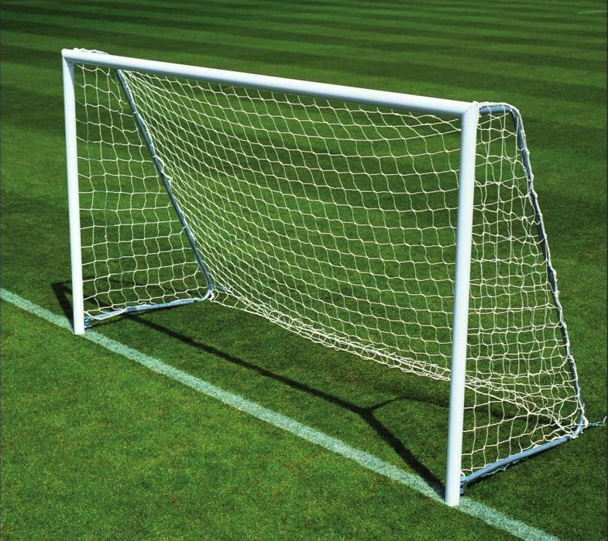
Let’s Practice!
Image retrieved from Google Images

